Slide 1
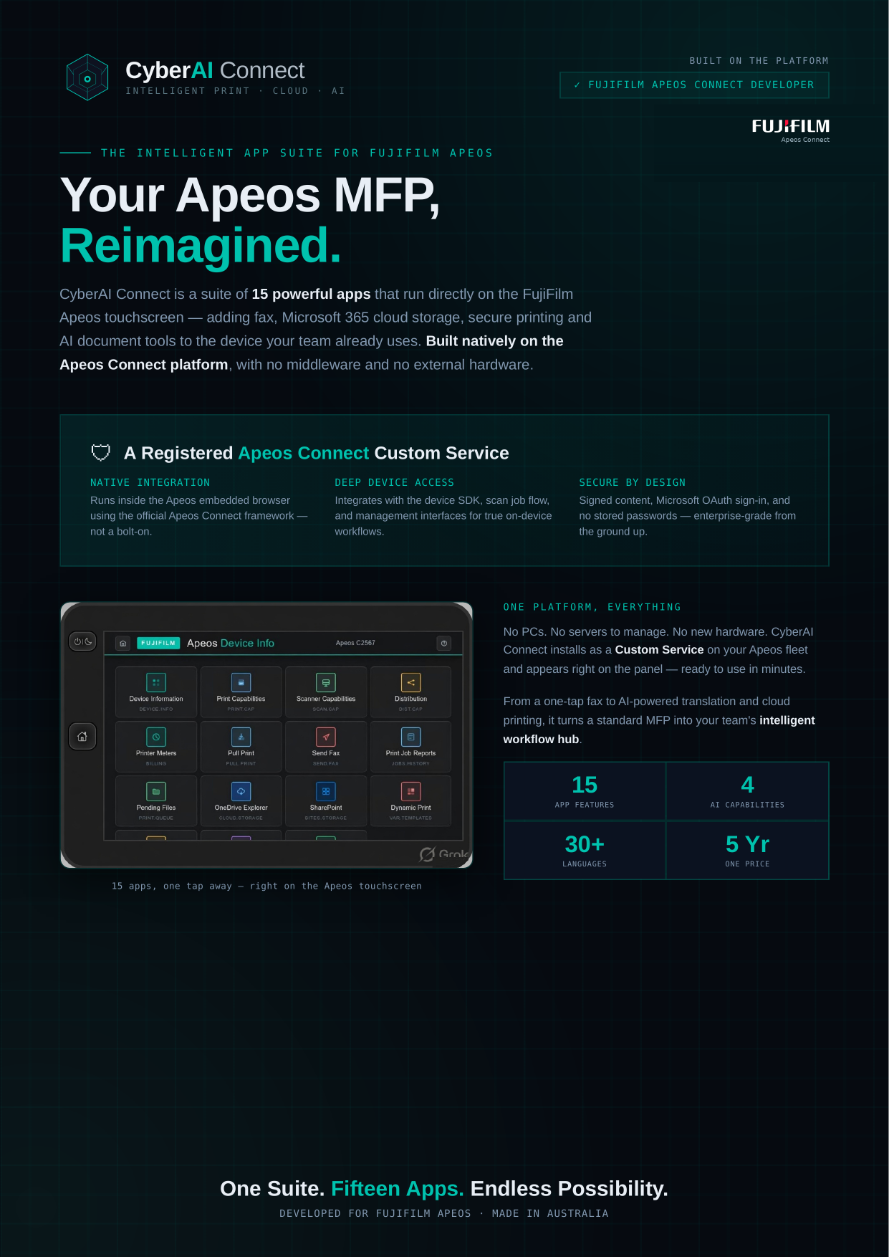
Notes:
Company Overview — Apeos CyberAI Connect brochure.

Slide 2
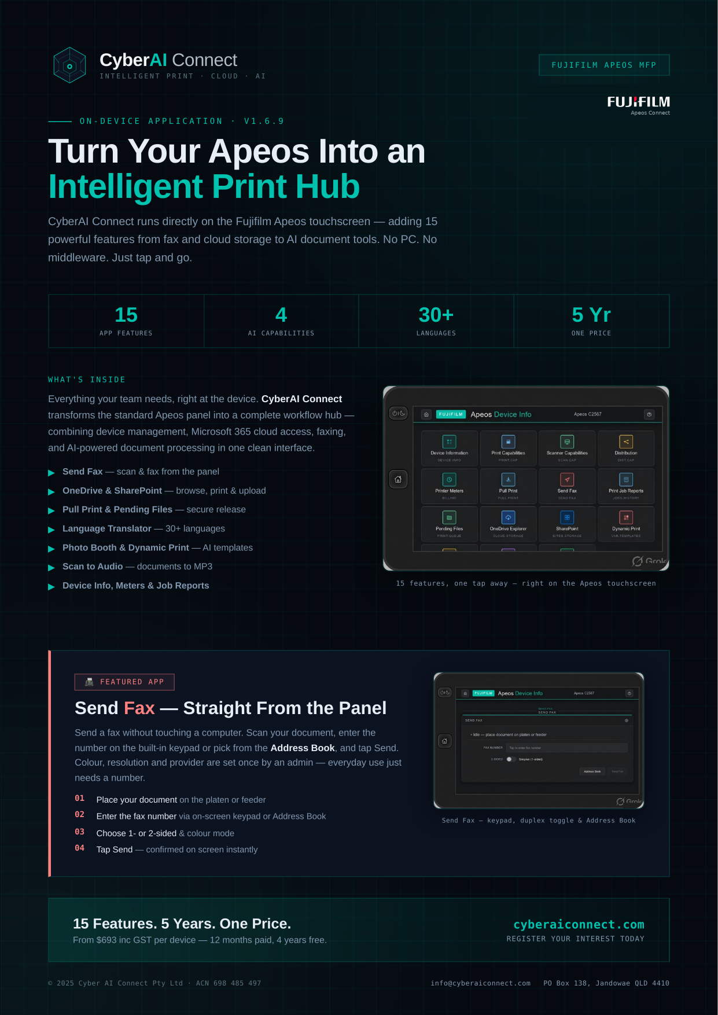
Notes:
CyberAI Connect — Apeos CyberAI Connect brochure.

Slide 3
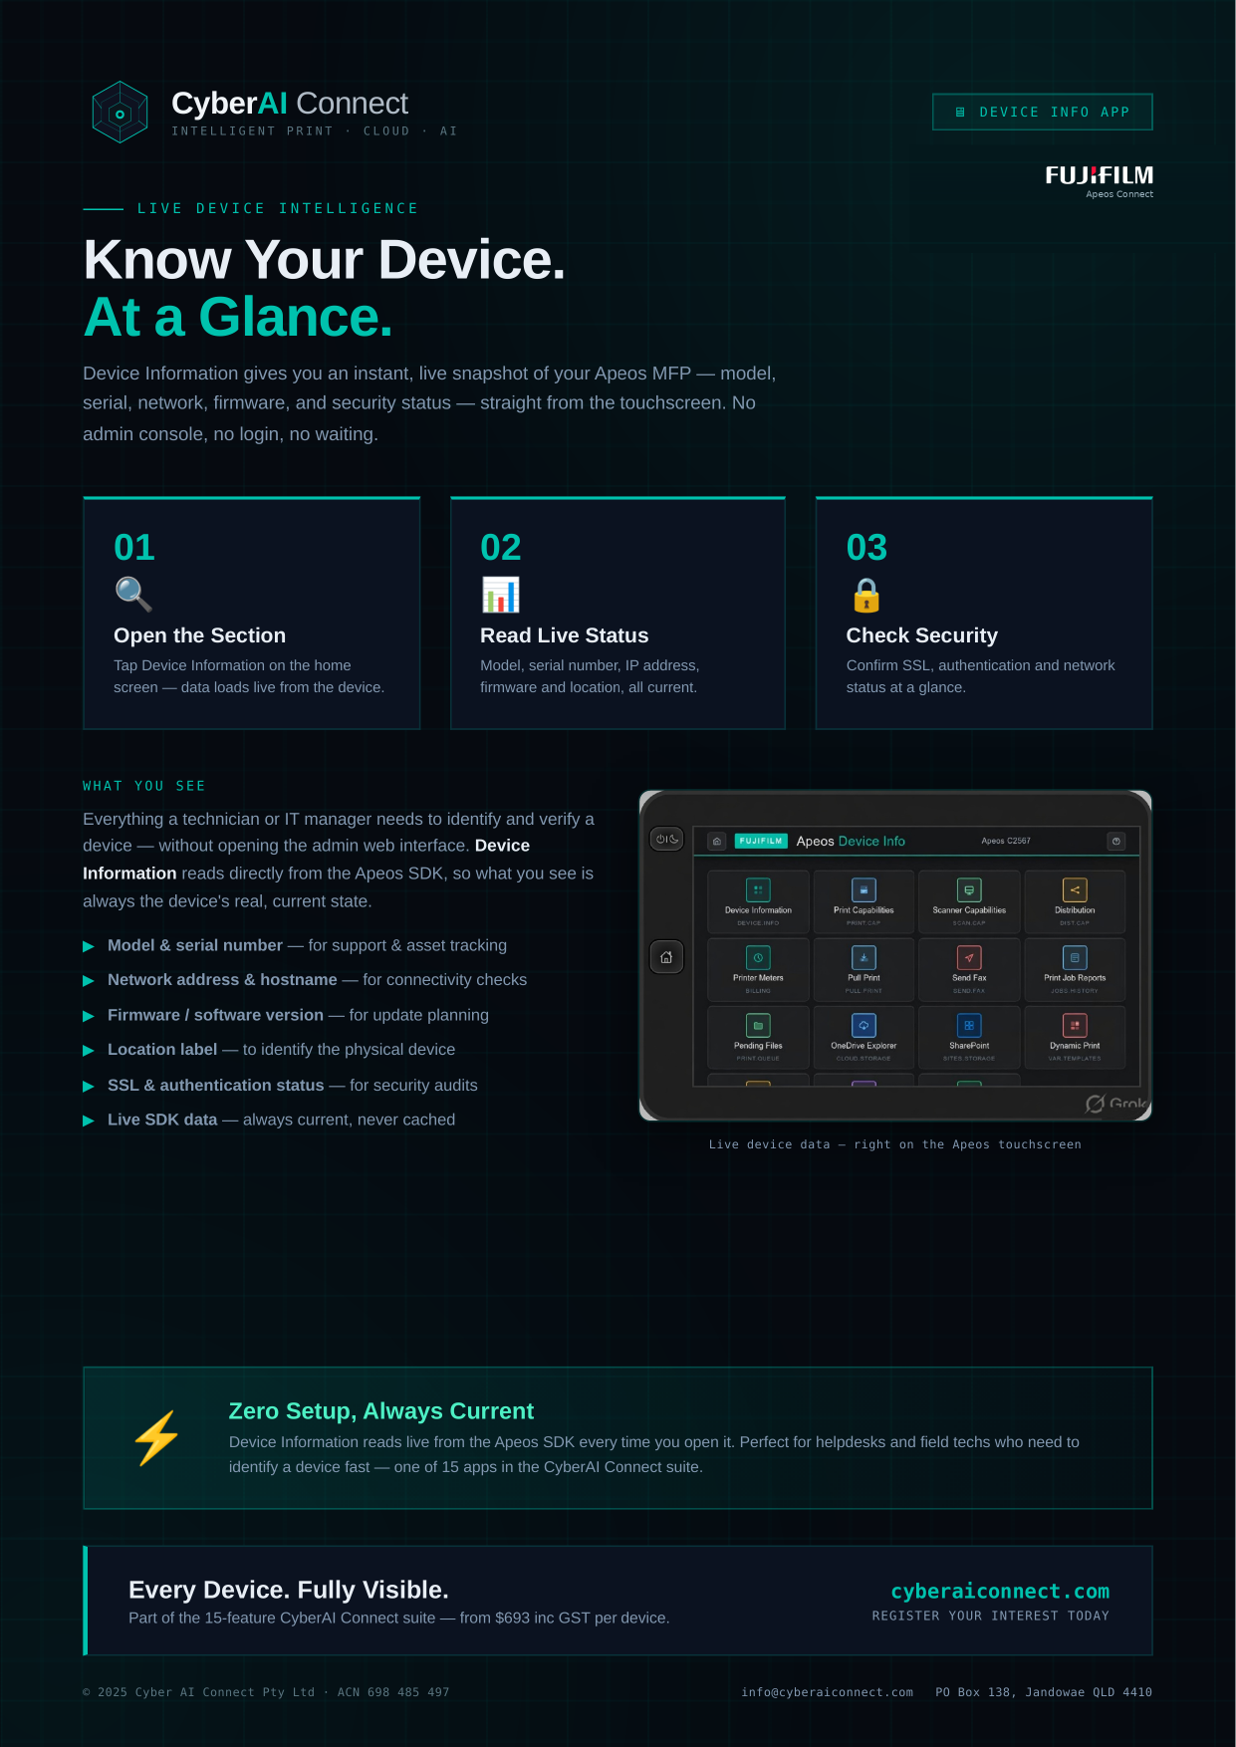
Notes:
Device Information — Apeos CyberAI Connect brochure.

Slide 4
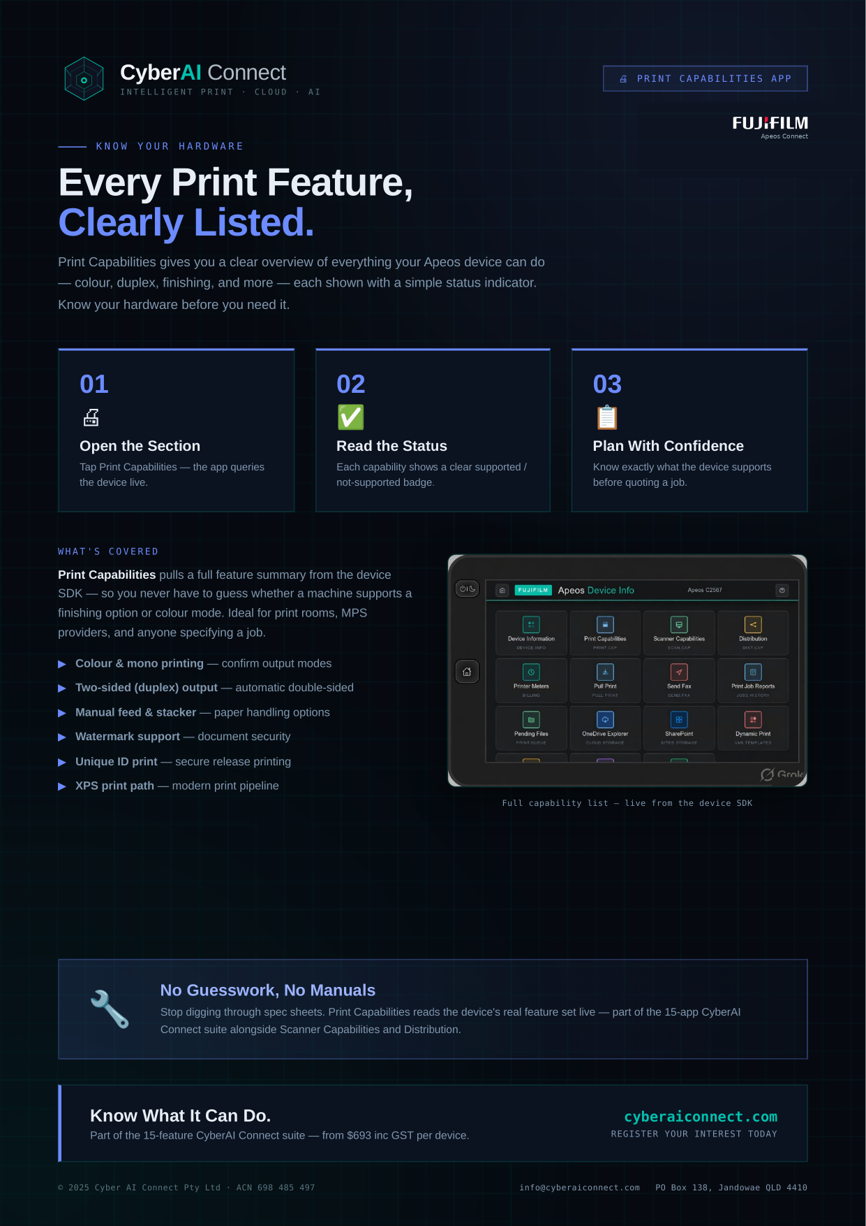
Notes:
Print Capabilities — Apeos CyberAI Connect brochure.

Slide 5
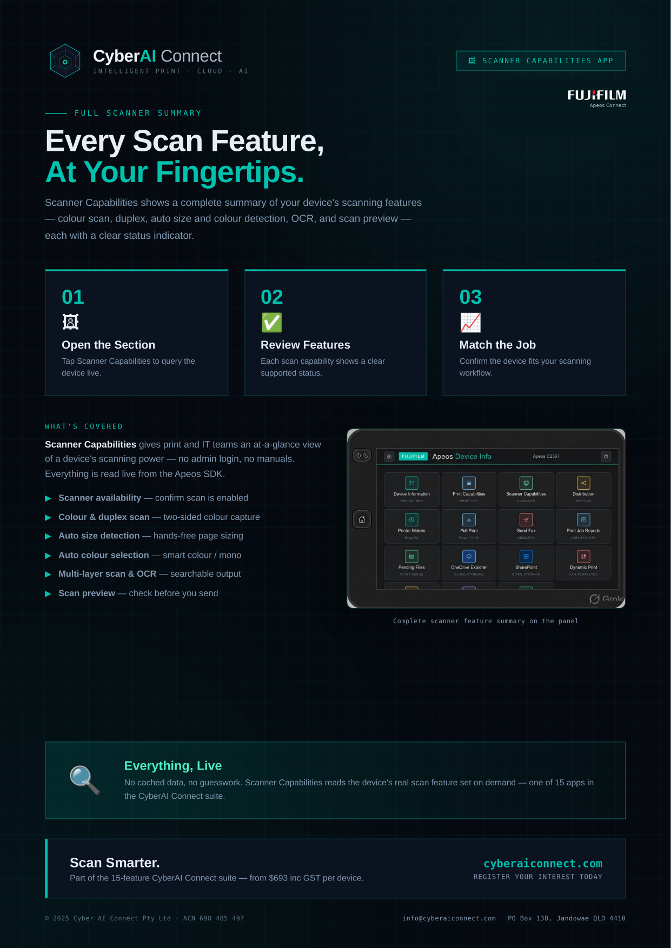
Notes:
Scanner Capabilities — Apeos CyberAI Connect brochure.

Slide 6
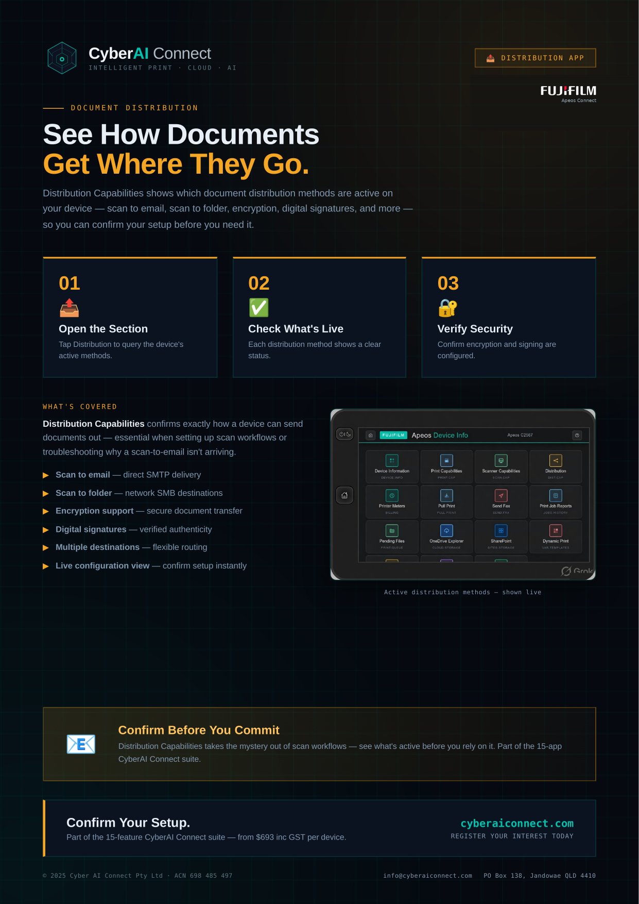
Notes:
Distribution — Apeos CyberAI Connect brochure.

Slide 7
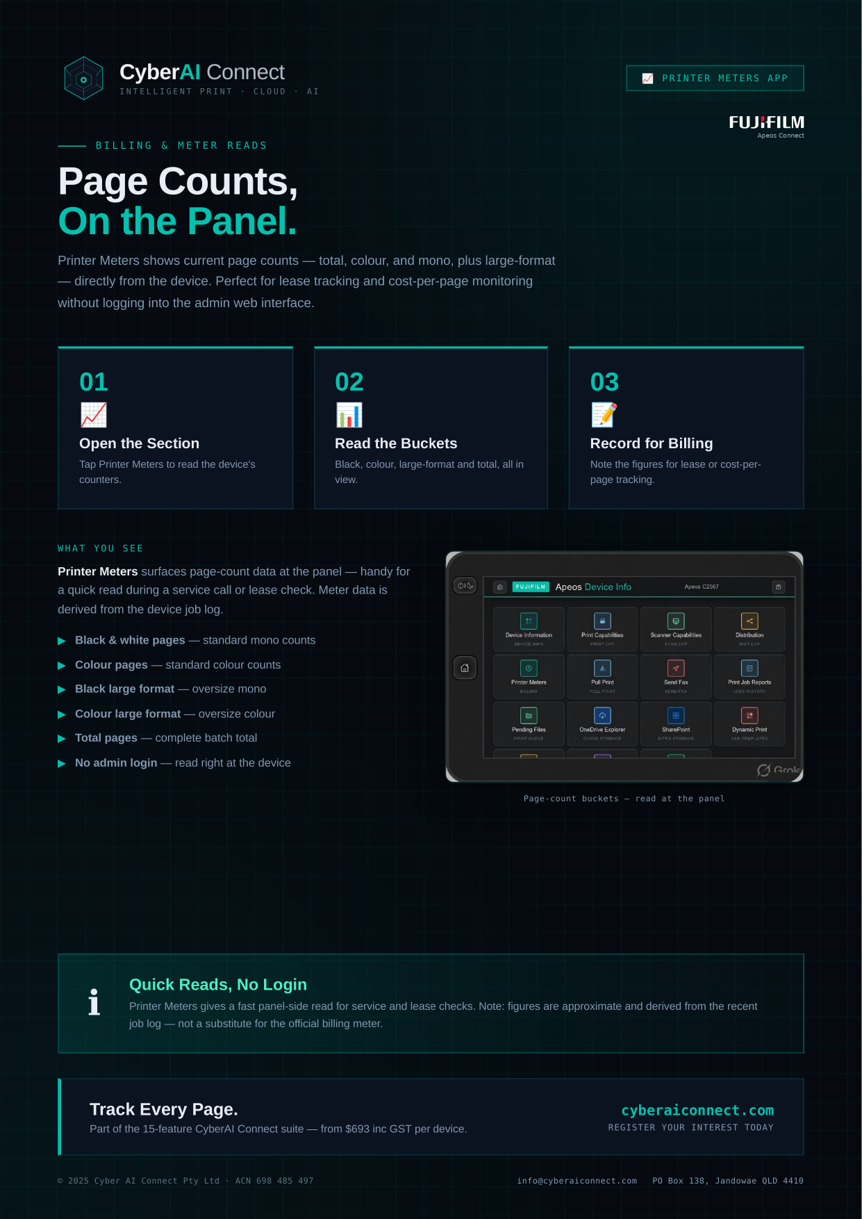
Notes:
Printer Meters — Apeos CyberAI Connect brochure.

Slide 8
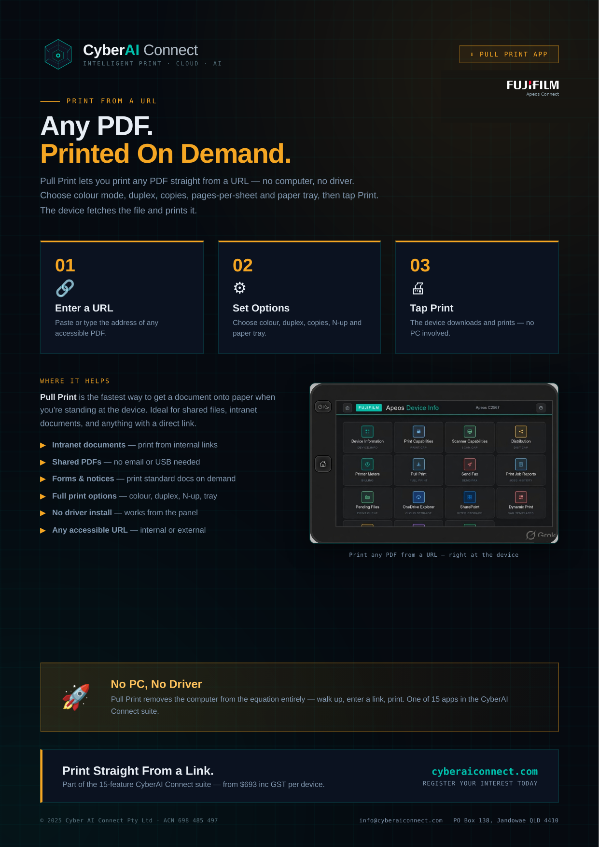
Notes:
Pull Print — Apeos CyberAI Connect brochure.

Slide 9
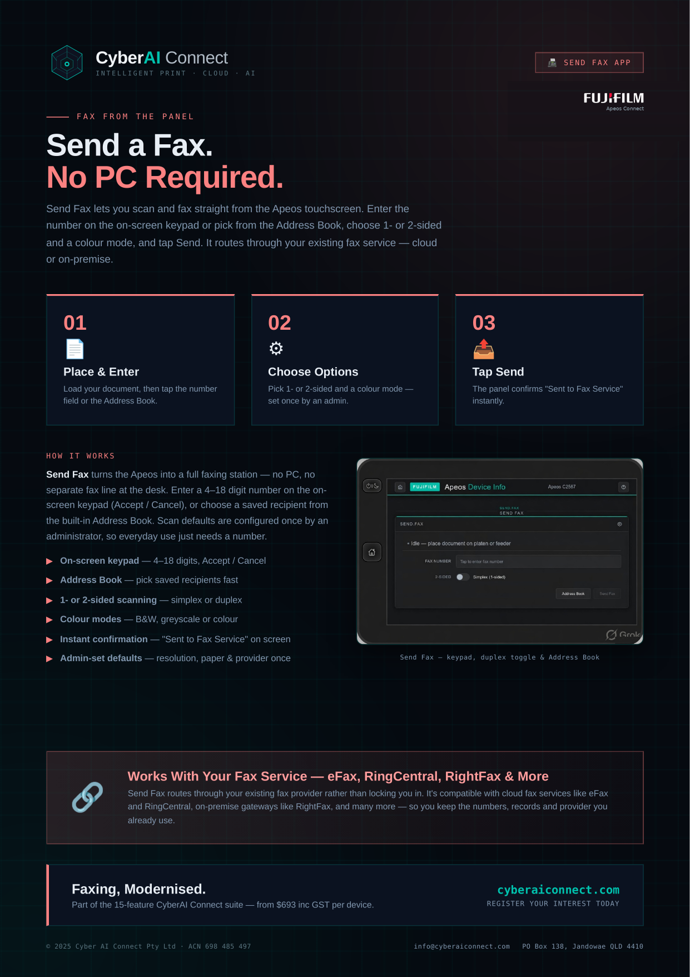
Notes:
Send Fax — Apeos CyberAI Connect brochure.

Slide 10
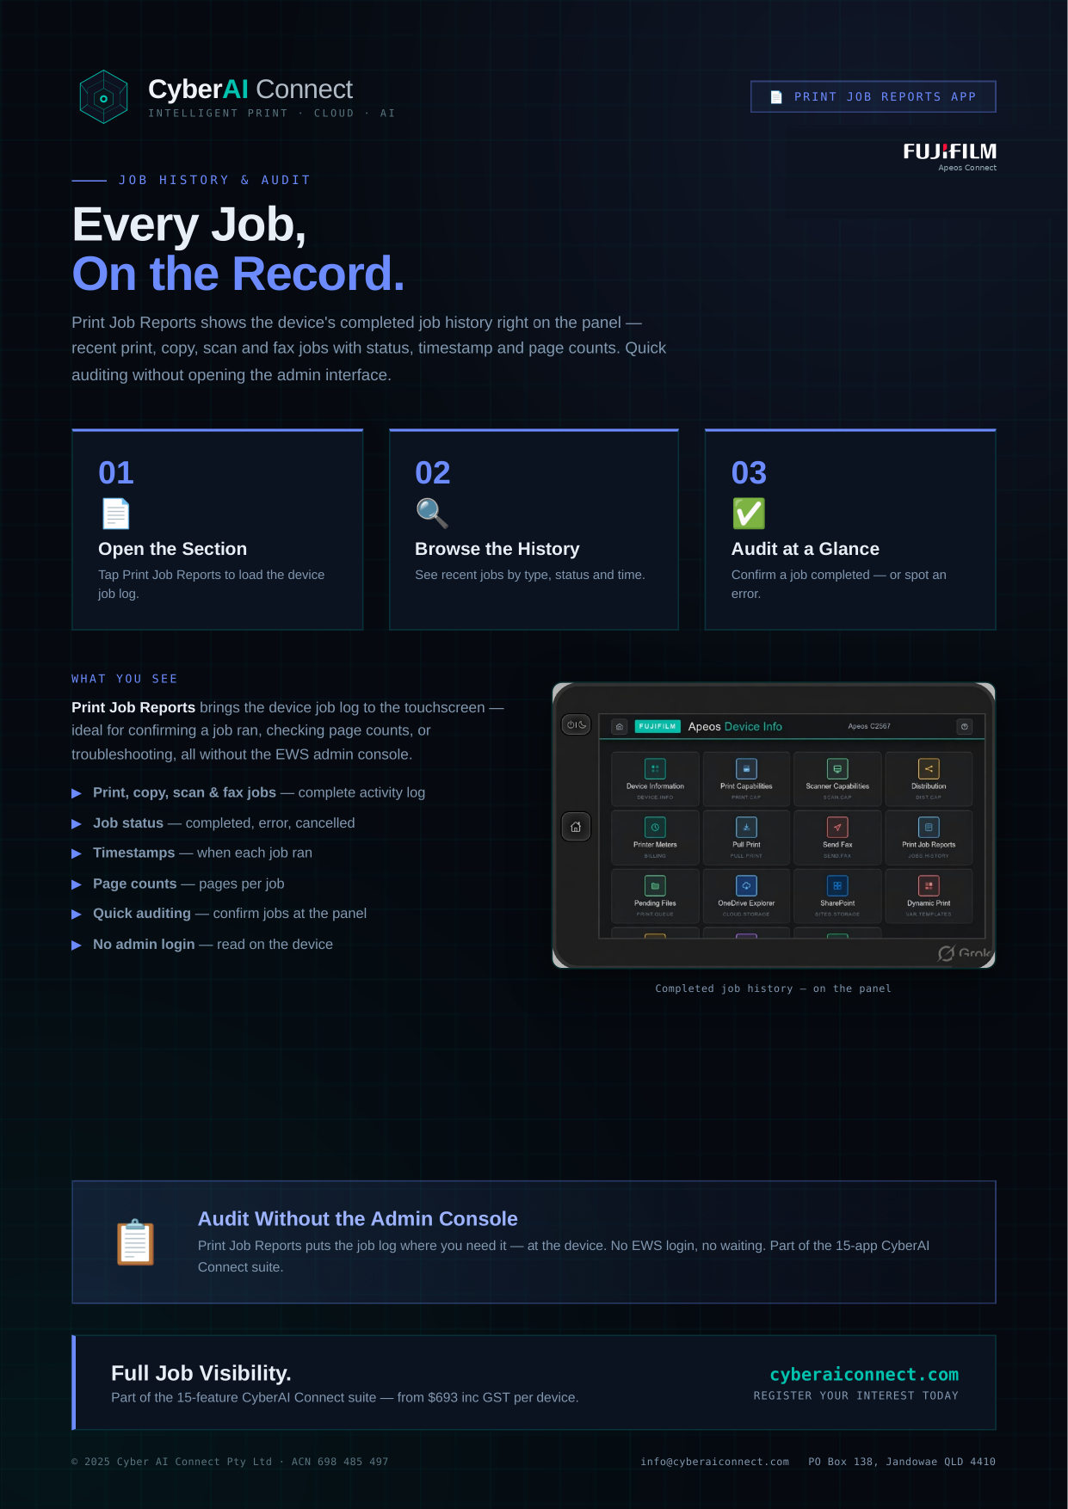
Notes:
Print Job Reports — Apeos CyberAI Connect brochure.

Slide 11
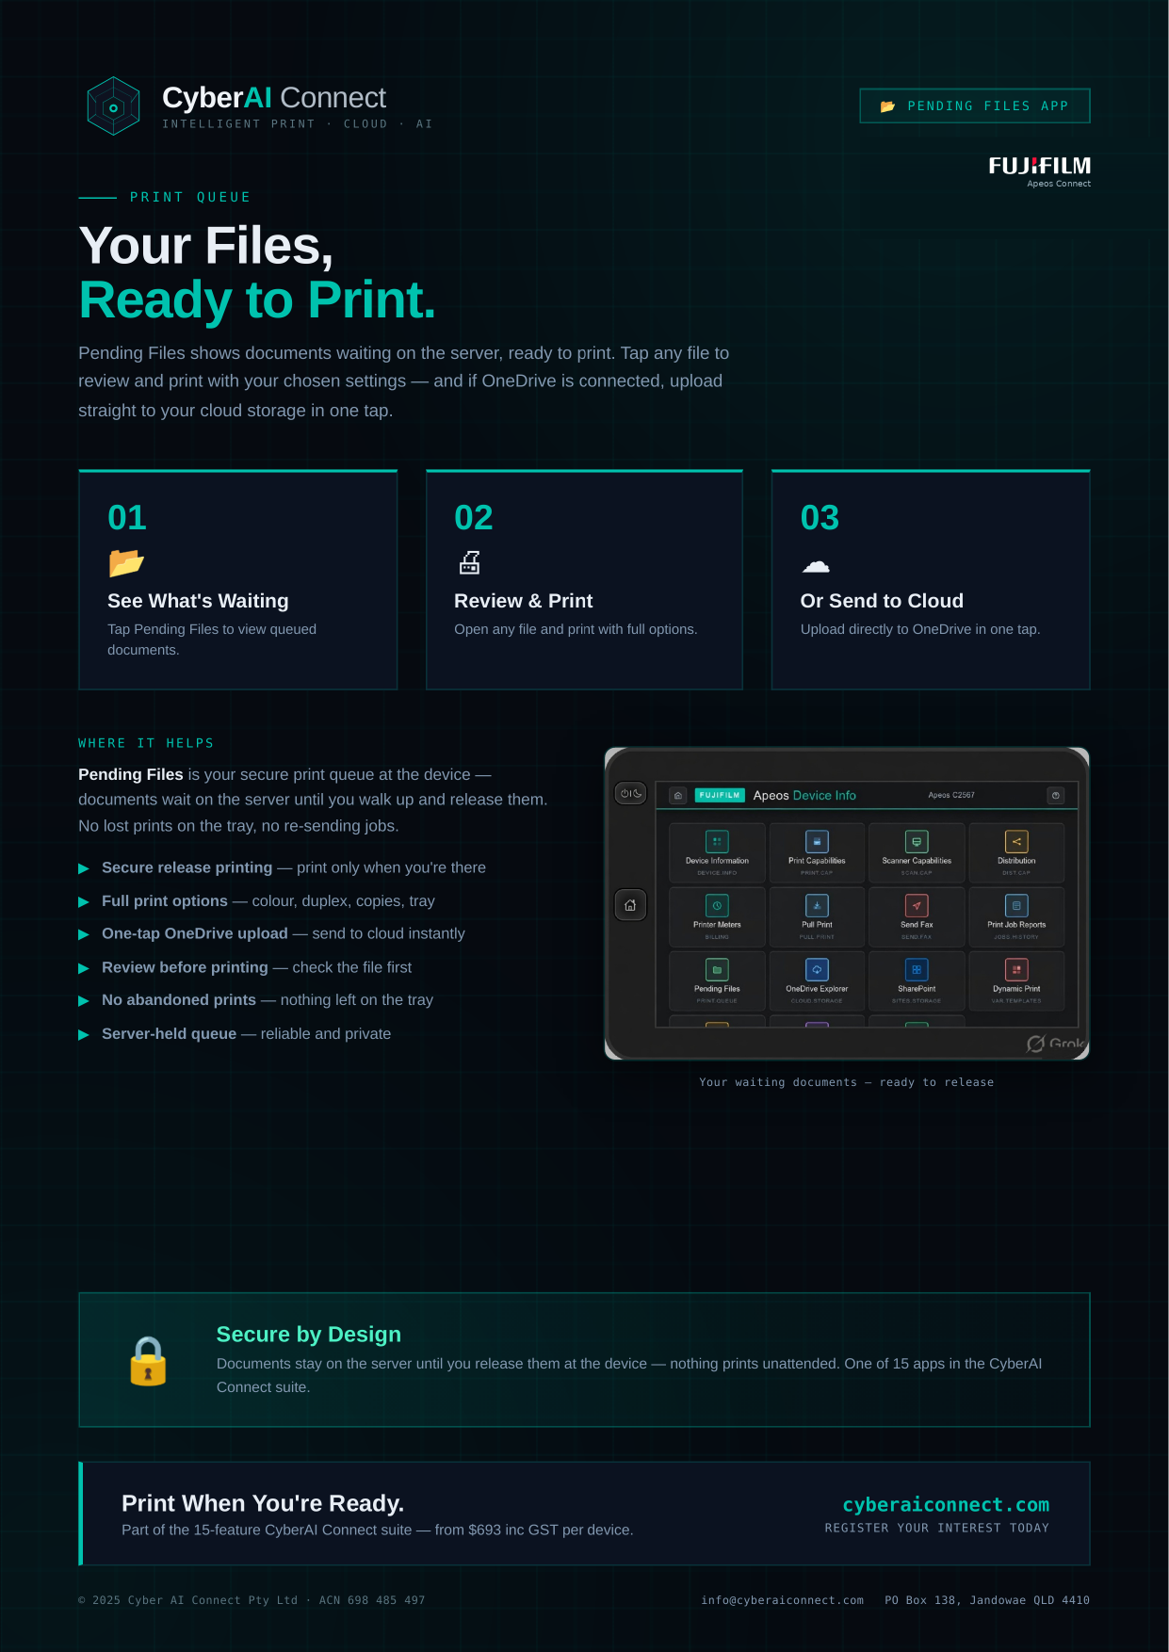
Notes:
Pending Files — Apeos CyberAI Connect brochure.

Slide 12
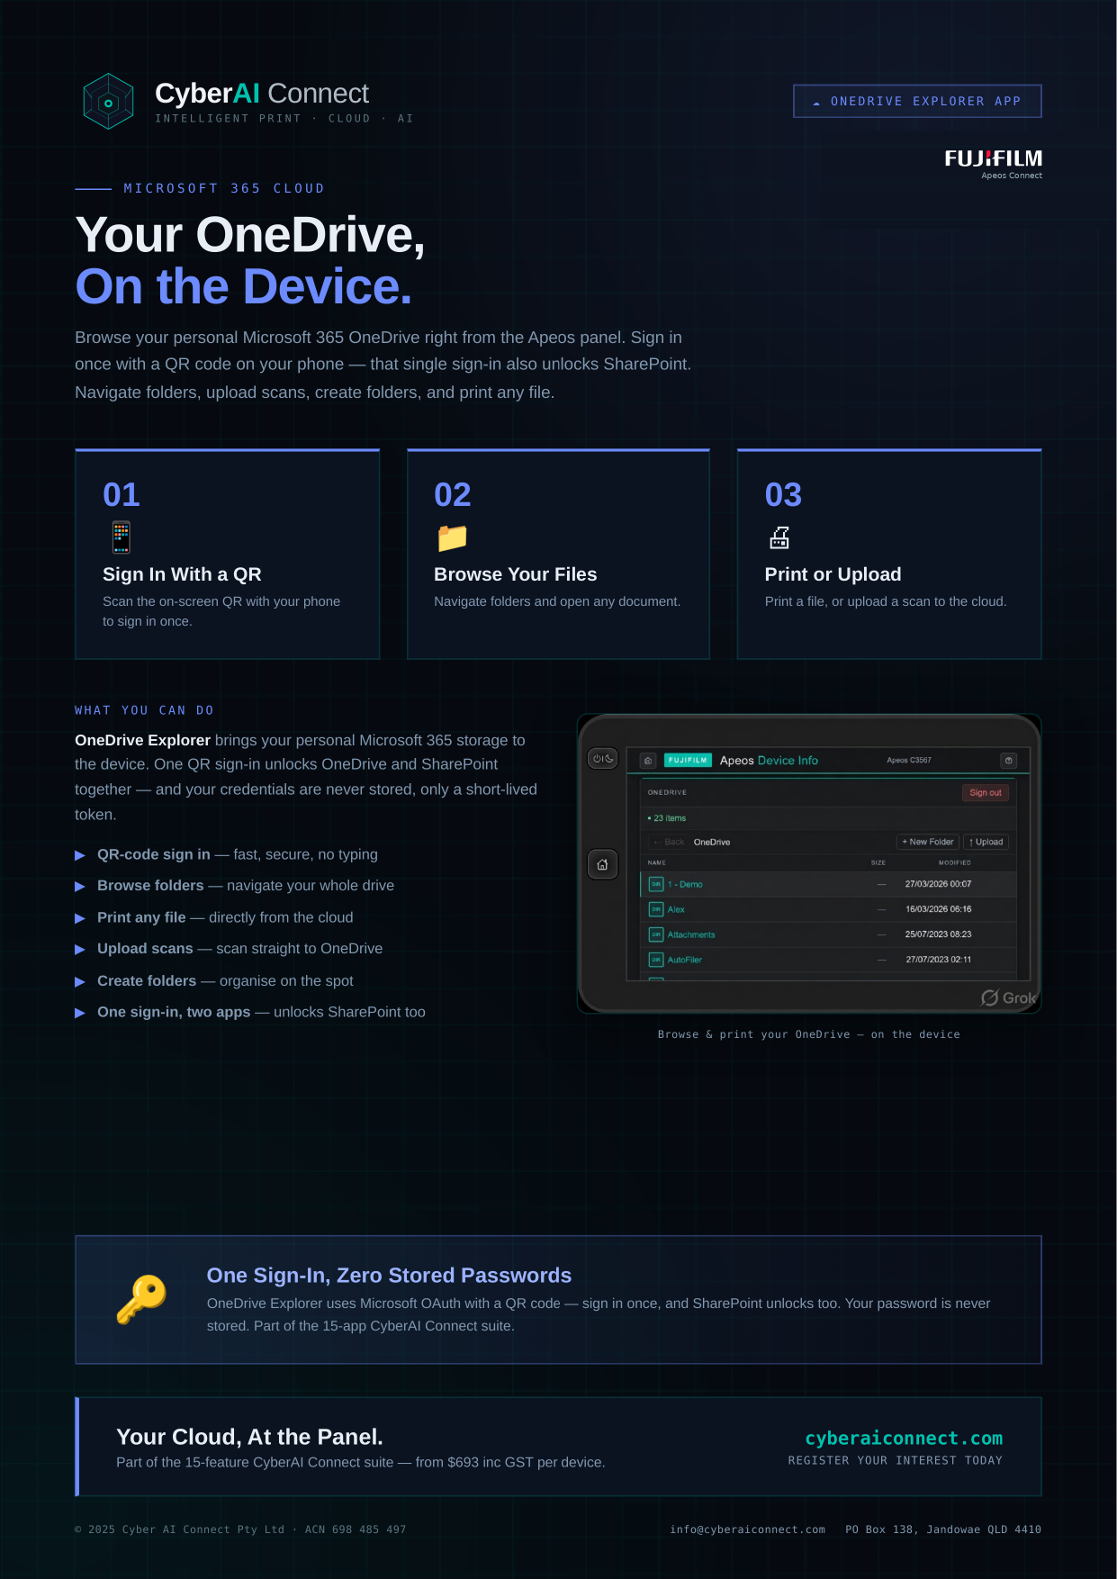
Notes:
OneDrive Explorer — Apeos CyberAI Connect brochure.

Slide 13
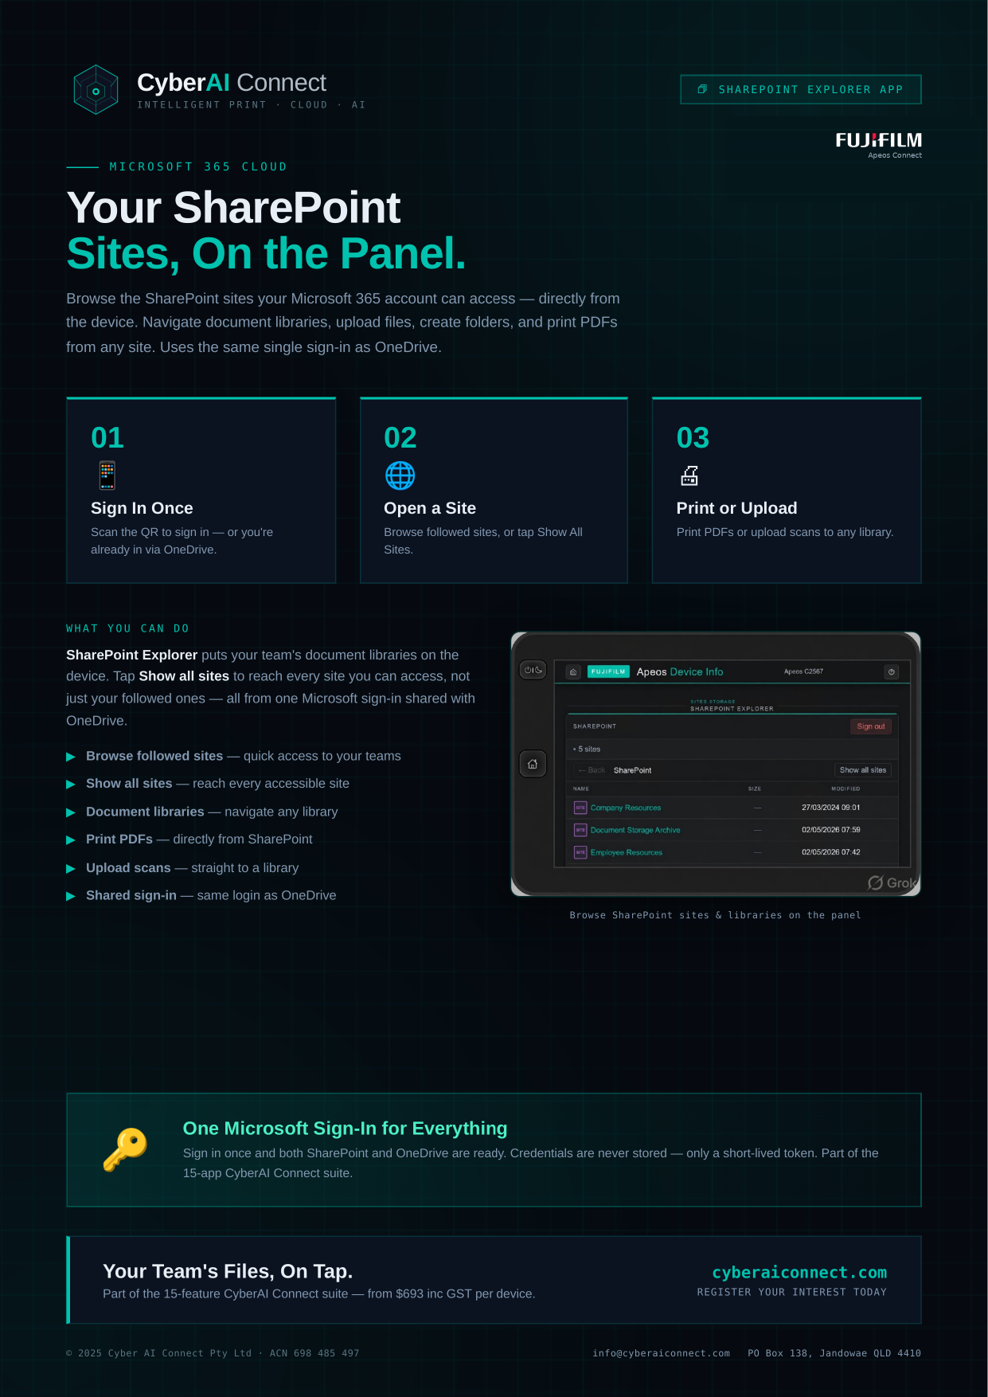
Notes:
SharePoint Explorer — Apeos CyberAI Connect brochure.

Slide 14
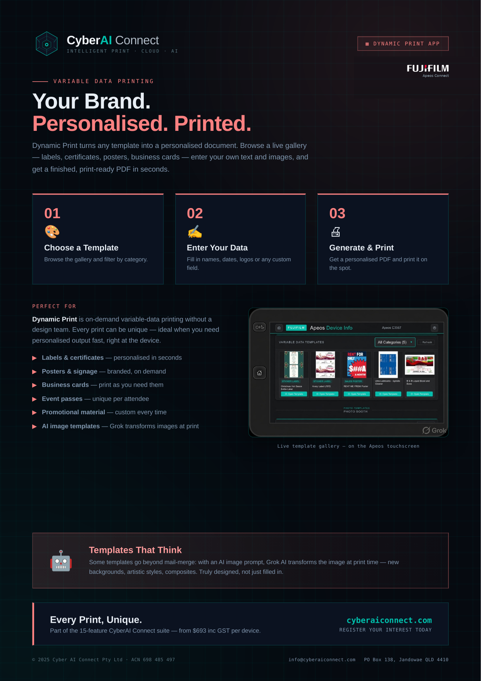
Notes:
Dynamic Print — Apeos CyberAI Connect brochure.

Slide 15
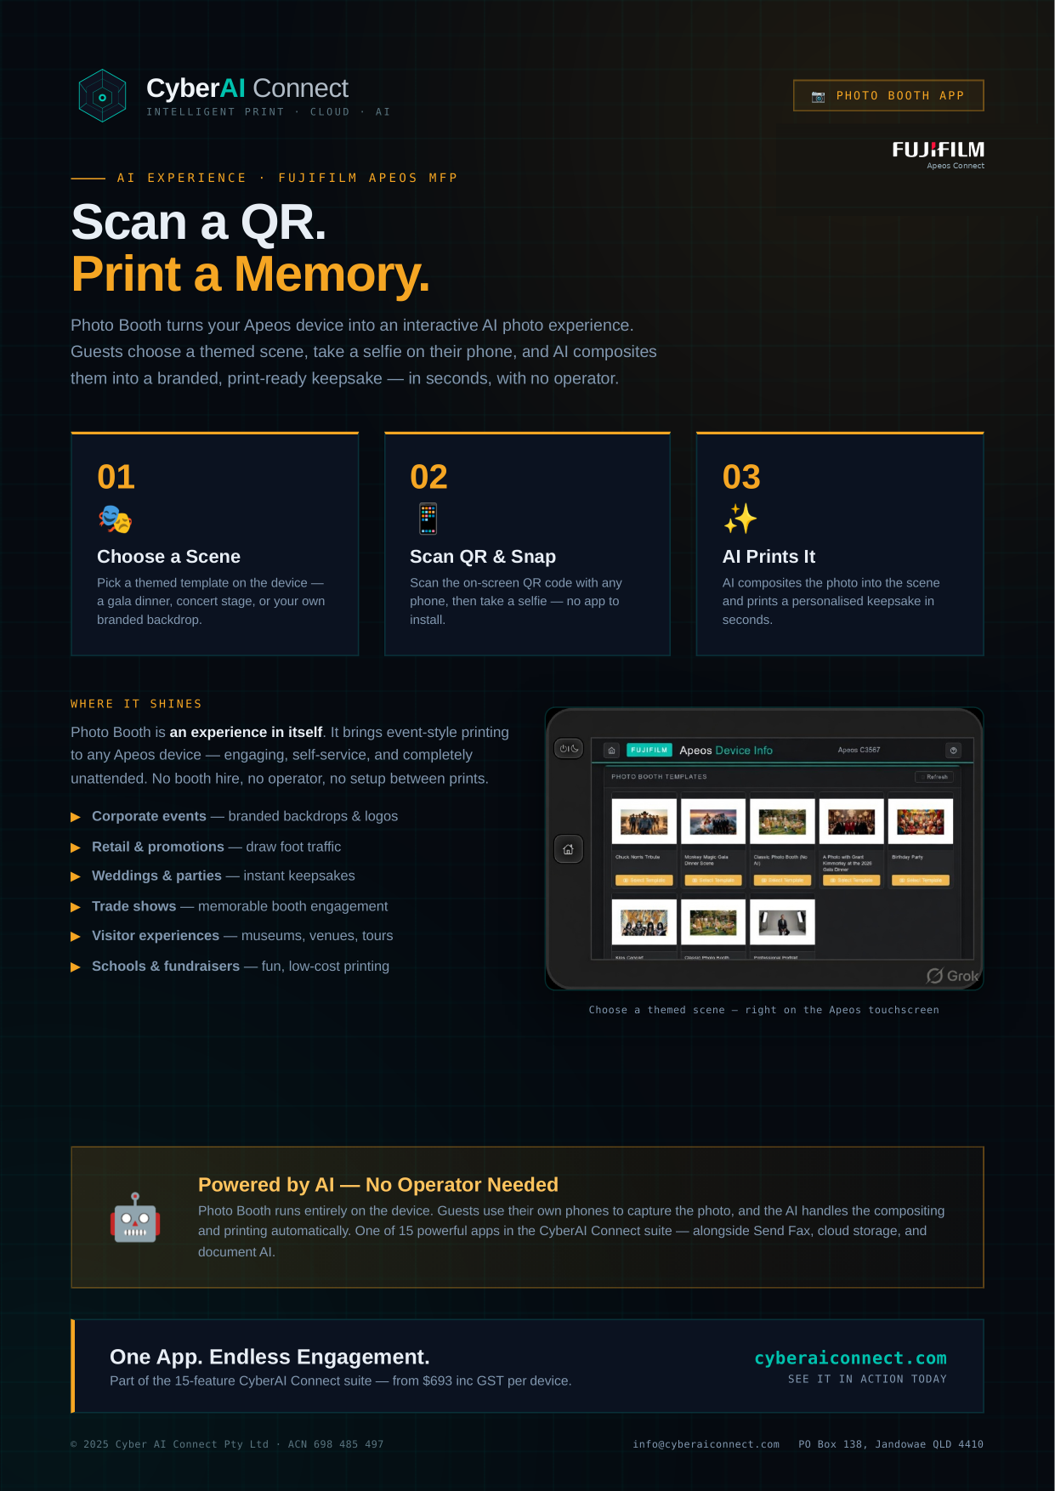
Notes:
Photo Booth — Apeos CyberAI Connect brochure.

Slide 16
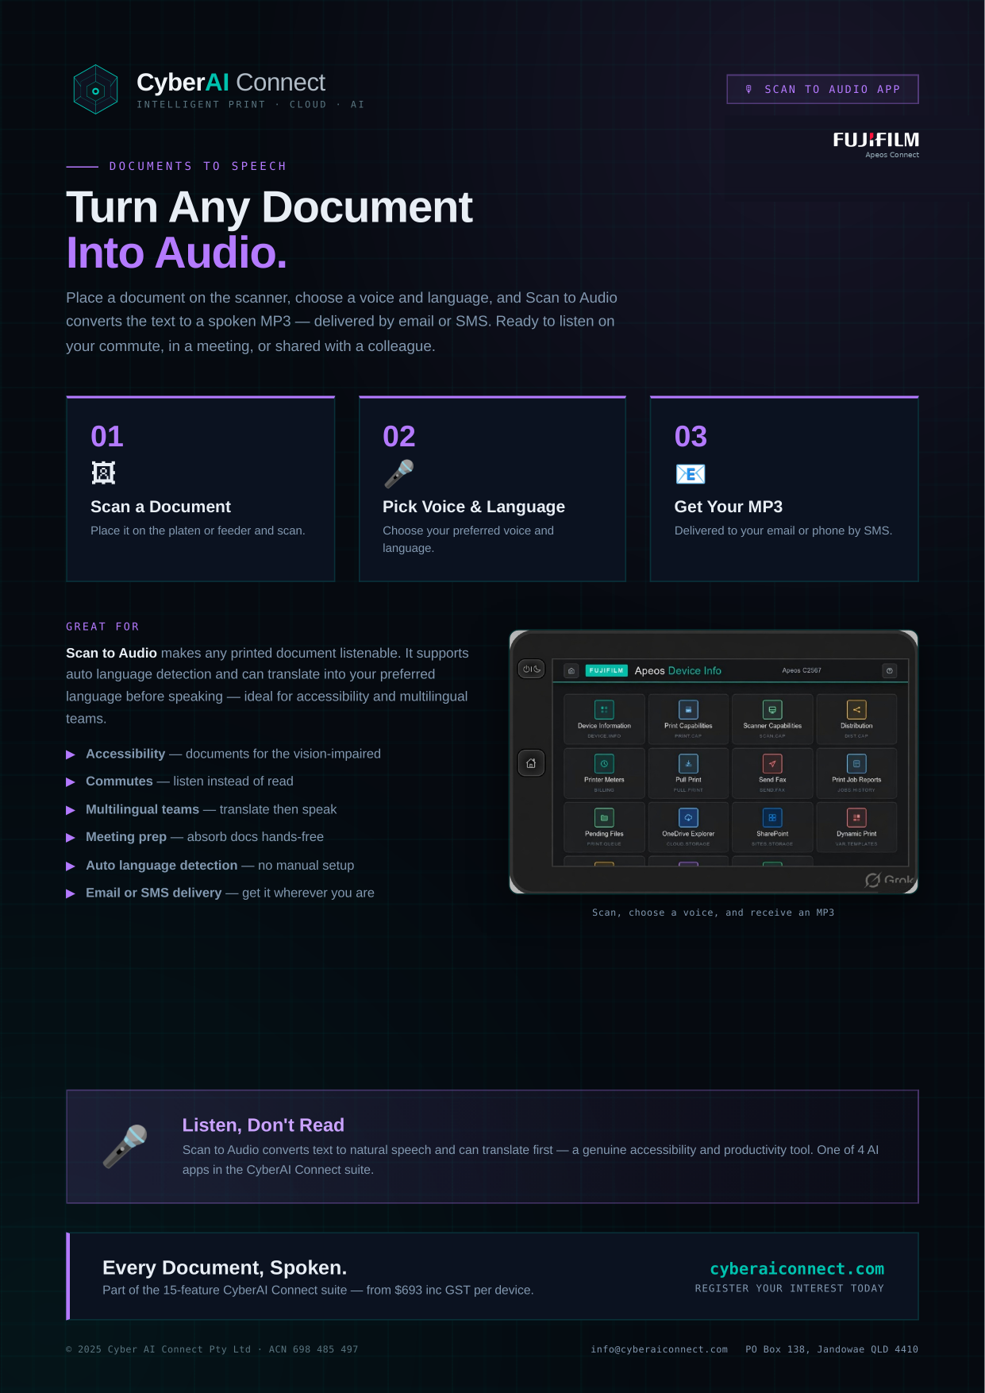
Notes:
Scan to Audio — Apeos CyberAI Connect brochure.

Slide 17
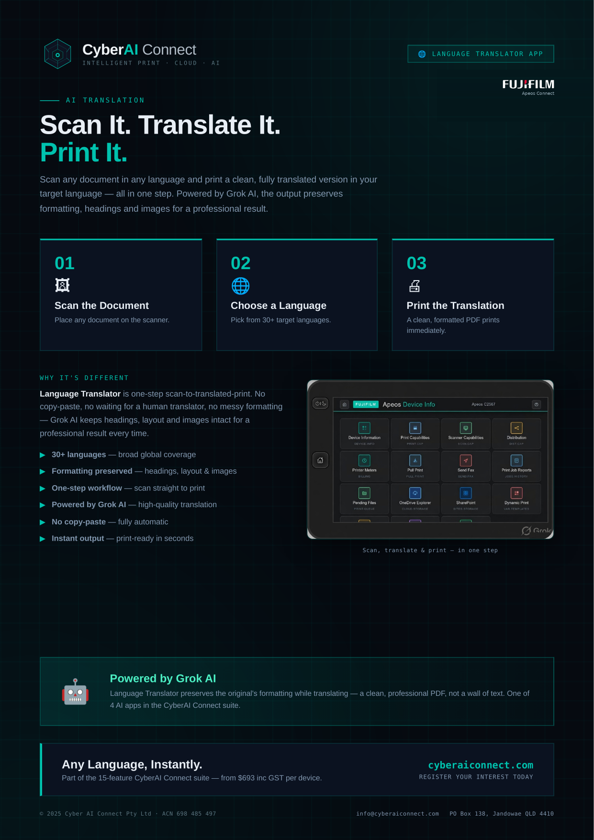
Notes:
Language Translator — Apeos CyberAI Connect brochure.

Slide 18
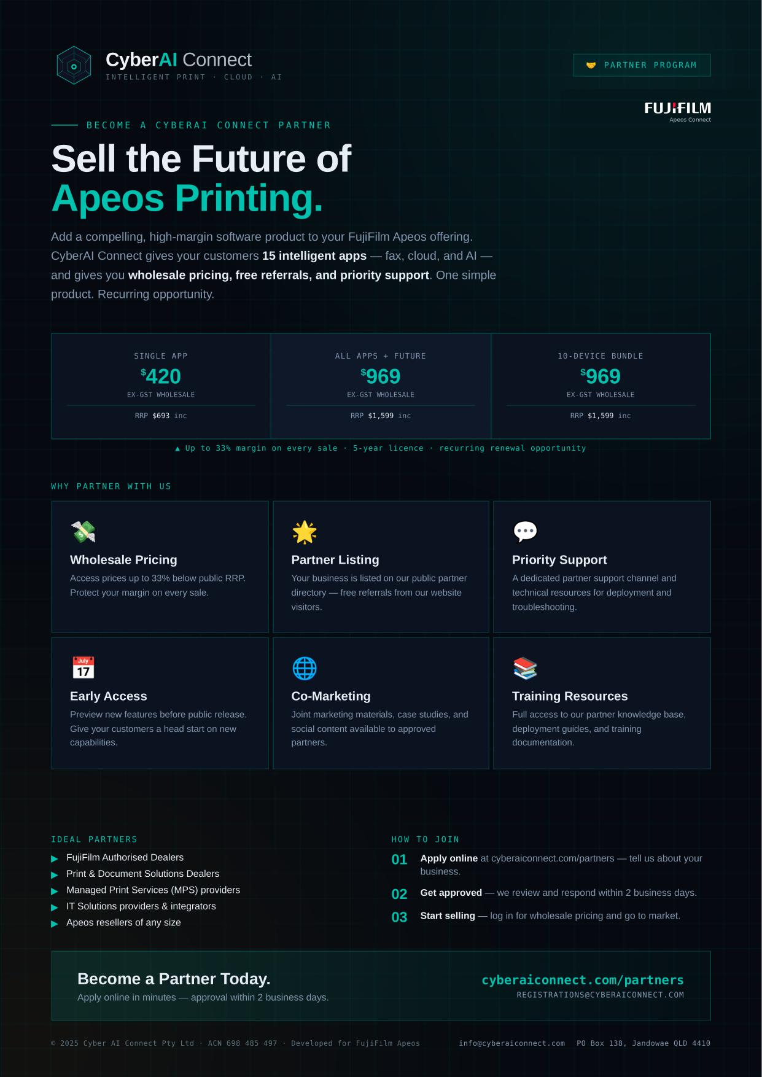
Notes:
Partner Program — Apeos CyberAI Connect brochure.

Slide 19
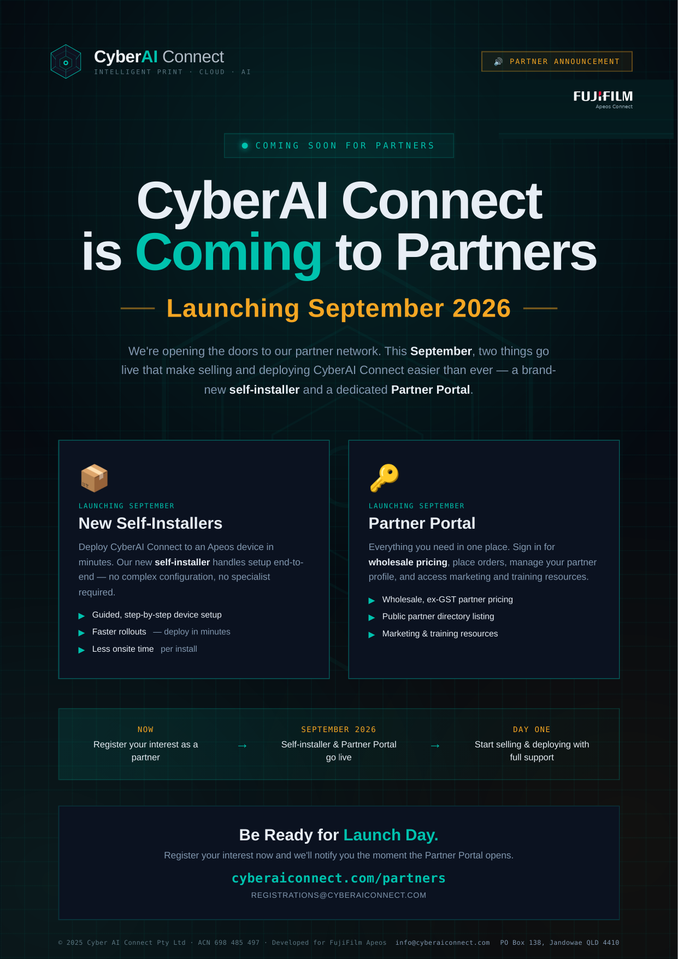
Notes:
Partners — Coming Soon — Apeos CyberAI Connect brochure.

